Slide 1
Lab 3: Design
Vu Tuan Hai

Slide 2
Week | Topic | Homework
1 | Overview about the workspace of a software engineer | Project plan Setup workspace
2 | Analysis | Usecase diagram Sequence diagram
3 | Design | Class diagram Database diagram UI / UX prototype
4 | Implement | N/A (coding)
5 | Testing | N/A (coding)
6 | Evaluation the project | Complete project

Slide 3
Class diagram
Class name
Composition
ACCOUNT
Username Hash Type
Update()
DETAIL_BILL
…
Attribute
CUSTOMER
Name
…
Method
Association
EMPLOYEE
Name: String Manager: Employee
UpdateName(String newname): Boolean
ITEM
Name Price Type
…
BILL
Date Type
…
Generalization
IMPORT_BILL
…
…
Detailed class

Slide 4
Class diagram
The class diagram is the hardest diagram. Defining classes base on:
- Requirement
- Usecase diagram
Entity => Attribute => Method => Relationship

Slide 5

Database diagram
Table
ACCOUNT
ID (PK) Username Hash Type
Key
DETAIL_BILL
ID_Bill (FK) ID_Item (FK)
CUSTOMER
ID (PK) ID_Account (FK) Name
Field
Relatiopship
ITEM
ID (PK) Name Price Type
EMPLOYEE
ID (PK) ID_Account (FK) Name ID_Manager
BILL
ID (PK) ID_Customer (FK) ID_Employee (FK) Date Type
IMPORT_BILL
…

Slide 6
Database diagram
Map classes to tables:
- Add key
Attribute => Field
Relationship => Foreign Key

Slide 7
Exercise
EMPLOYEE
ID (PK) ID_Account (FK) Name ID_Manager
Library management database
Book: ID, Name, ID_Author, Pages, ...
Author: ID, Name, Age, ...
Reader: ID, Name, Age, ...
Status: ID_Reader, ID_Book, Due date, ...
…
=> Draw database diagram
BILL
ID (PK) ID_Customer (FK) ID_Employee (FK) Date Type

Slide 8
Homework
Research about business (ref Git/References/SampleBAReport)
Draw database diagram of your project.
Deadline: 2 weeks.

Slide 9
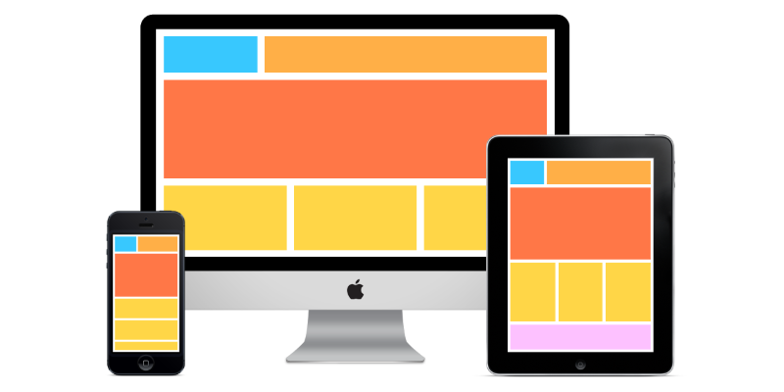
UI/UX

Slide 10
UI/UX
What is a good UI/UX?
- Usable
- Less interaction as much as possible
Color, size, layout, typography, smoothness, ...
- Advanced UI / UX: visual research, micro – interaction, animation, …

Slide 11
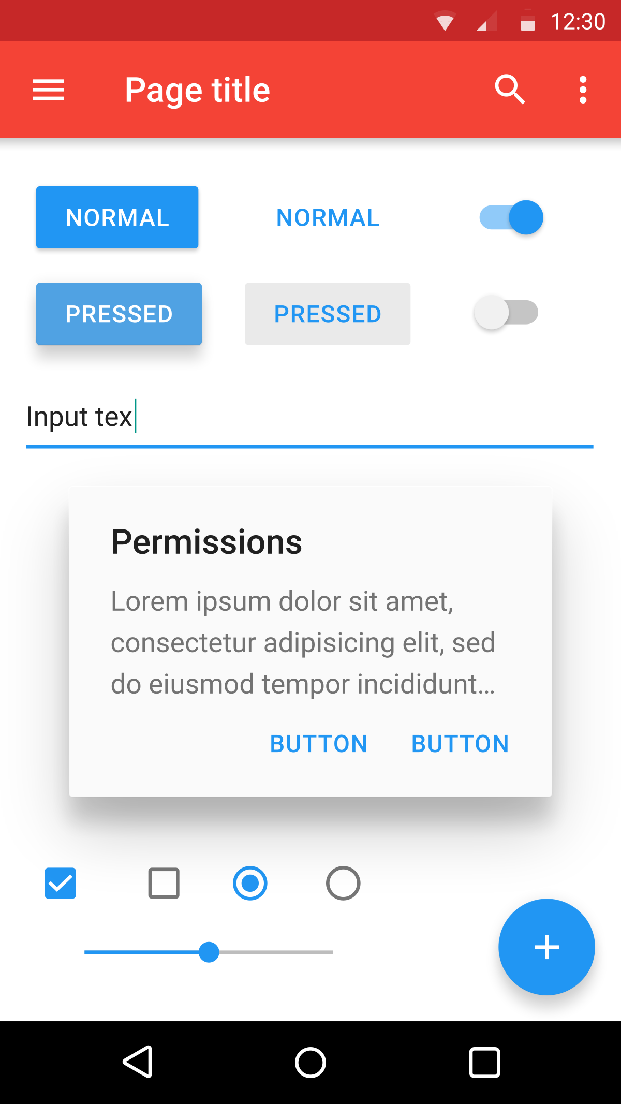
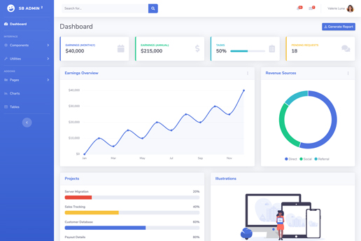
UI/UX
Material design
Some tips:
Use template
Refer similar system
Imagine that you are in user’s position
Bootstrap

Slide 12
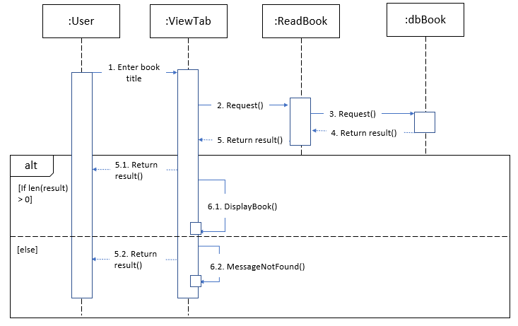
Example
A library is doing the digitization of book management. Readers can view book information online based on book title.

Slide 13
Design UI/UX
First step: research base on
Usecase diagram: How many pages? => Home many usecases?
Sequence diagram: How UI should be? => How does function work?

Slide 14
Design UI/UX
3 pages: Home, SearchResult, DetailBook
Script:
Home: show book by category (newest, most read, …), contain search bar.
SearchResult: show a list of the satisfying books, if the number of books is zero, show a message box.
DetailBook: show information of a specific book

Slide 15


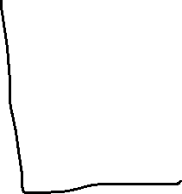

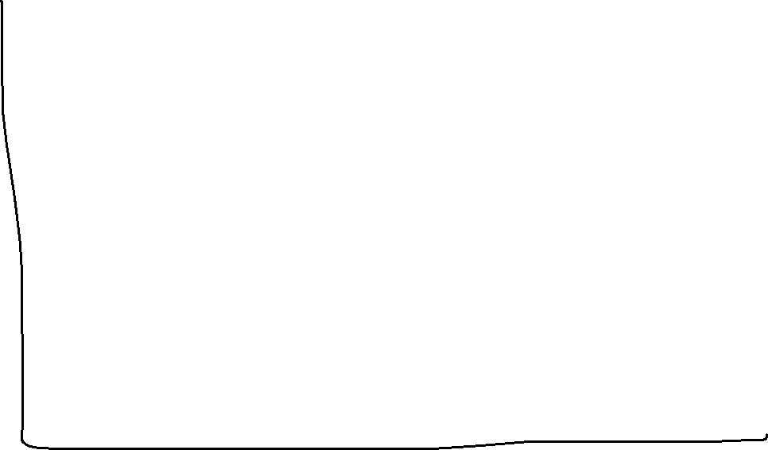






Slide 16
Design UI/UX
Second step: draw user flowchart (how is transition between pages?)
Home
Search
SearchResult
Start
View detail
DetailBook

Slide 17
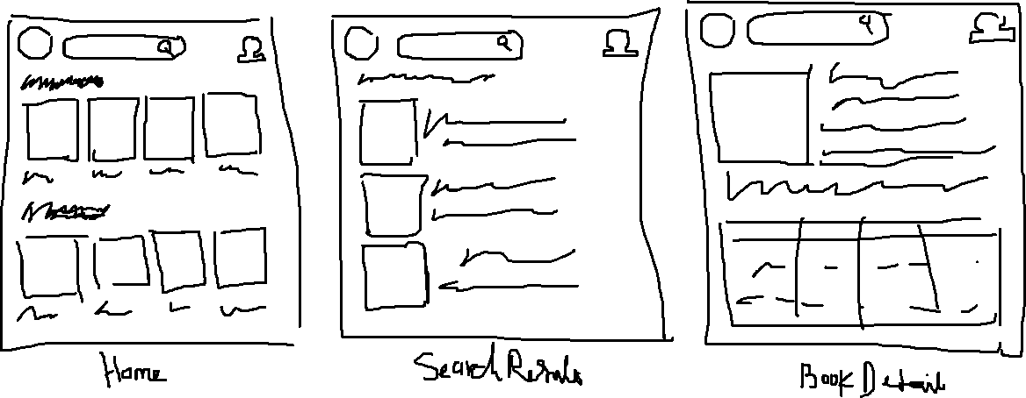
Design UI/UX
Third step: draw sketches

Slide 18
Design UI/UX
Fourth step: draw wireframe / prototype (use Figma)

Slide 19
Design UI/UX
Bài tập: Thiết kế giao diện cho trang chủ cho trang web xem trực tiếp World Cup.

Slide 20
Homework
Usecase + Sequence diagram
Draw database diagram (submit on folder Diagram) and prototype of your project (replace link in README.md)
Deadline: 2 weeks

Slide 21
Question

